Slide 1
JPanels

Slide 2
JPanel
A JPanel is both a container and a component
You can set up a Jpanel much like you would a Jframe, however it will not show up on the screen until it is added to a JFrame.
They can be used to occupy the entire frame or can be used to compartmentalize a frame.

Slide 3
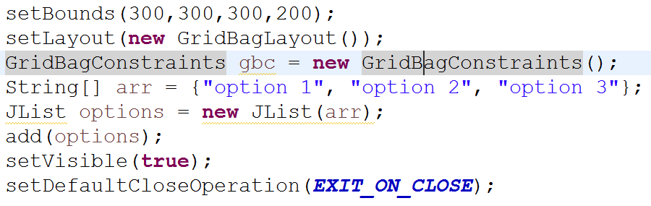
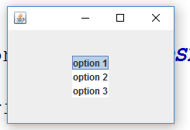
JList
A JList can be used to display a list of items of which you would like the user to select one.
Create a String array with the options, then instantiate the JList with the String[] as the parameter. You can then add it to the panel or frame.
Find the selected Value with the getSelectedValue() method

Slide 4
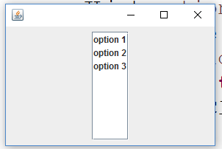
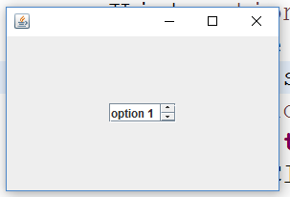
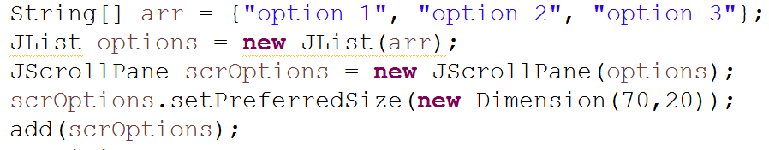
JscrollPane
A JScrollPane can be used to make your JList Scrollable if you would like to. If your List extends beyond the size, you it will become scrollable. You instantiate JScrollPane with the JList as the parameter.
Not Scrollable
Scrollable after setPreferredSize

Slide 5
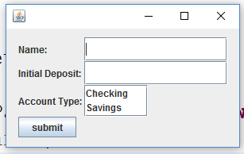
Assignment
Create a Jpanel which will input all information needed in order to create a BankAccount from our previous projects. Add the panel to a frame. Once the information is “submitted” a new Checking Account or Savings Account object should be created and added to an ArrayList of BankAccounts stored within the JPanel.

